Slide 1
RESPONSE ENTITY

Slide 2
Table of Content
1
What is Response Entity
2
Why must use Response Entity
3
How to use Response Entity

Slide 3
What is Response Entity

Slide 4
What is Response Entity
ResponseEntity is an object returned from a software system or web service to provide information or results back to other users or applications. It contains data and information regarding the status, result, or message of a processed request.

Slide 5
Why must use Response Entity

Slide 6
Why must use Response Entity
Customize HTTP response: With ResponseEntity, you have fine-grained control over the HTTP response. You can set the desired status code, headers, and response body.
Flexibility: It allows you to handle various scenarios, such as returning different status codes for success or error conditions, setting custom headers, and providing specific response bodies.
Consistency: By using ResponseEntity consistently throughout your application, you ensure a standardized approach to constructing and returning HTTP responses.

Slide 7
How to use Response Entity

Slide 8
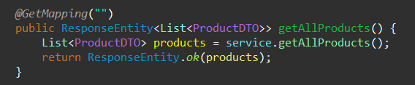
How to use Response Entity
Tạo mới object dạng new ResponseEntity<>(user, HttpStatus.OK)
Dùng dạng static method ResponseEntity.ok(user)
Dùng dạng builder ResponseEntity.status(HttpStatus.BAD_REQUEST).body("User not found").build()

Slide 9
MICROSERVICE

Slide 10
Table of Content
1
What is Microservices
2
Why must use Microservices
3
How to use Microservices

Slide 11
What is Microservices

Slide 12
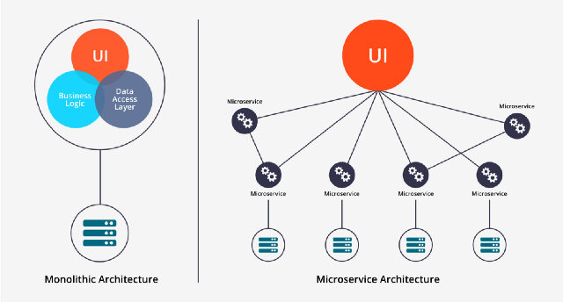
What is Microservices

Slide 13
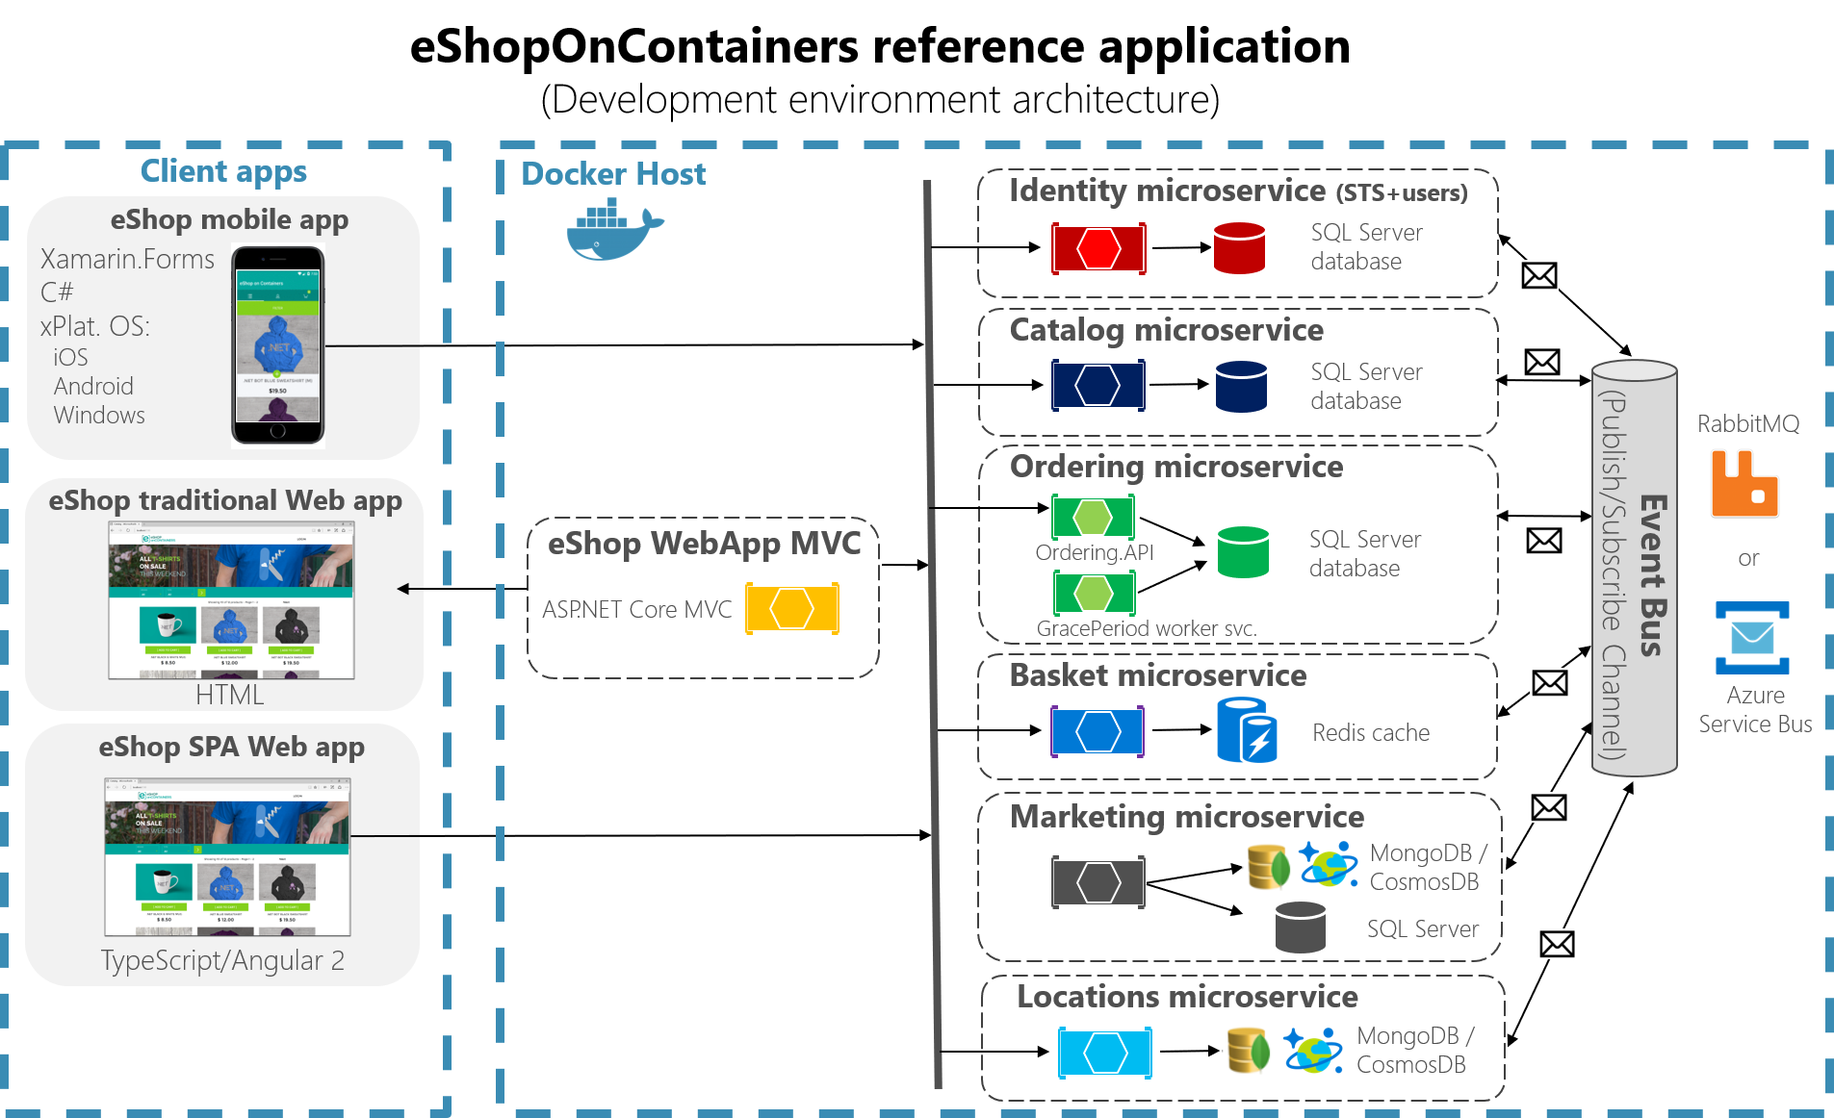
What is Microservices

Slide 14
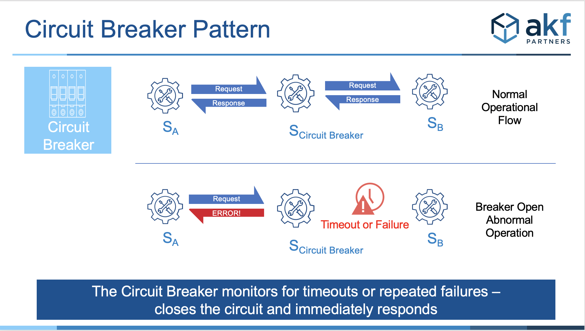
Circuit Breaker

Slide 15
Why use Microservices

Slide 16
Advantages of Microservices
1
Scalability
2
Technology Diversity
3
Independence
4
Resilience

Slide 17
Disadvantages of Microservices
1
Difficult to code
2
Difficult to manage
3
Profesional team

Slide 18
How to use Microservices

Slide 19
Thank You

